Slide 1
Binary Search Tree Session 11-12
Course : Data Structures
Effective Period : December 2018

Slide 2
Learning Outcomes
At the end of this session, students will be able to:
LO 1: Explain the concept of data structures and its usage in Computer Science
LO 2: Illustrate any learned data structure and its usage in application
LO 3: Apply data structures using C

Slide 3
Outline
Binary Search Tree
Binary Search Tree Operations
Program Example

Slide 4
Binary Search Tree
Binary Search Tree (BST) is one such data structures that supports faster searching, rapid sorting, and easy insertion and deletion
BST is also known as sorted versions of binary tree
For a node x in of a BST T,
the left subtree of x contains elements that are smaller than those stored in x,
the right subtree of x contains all elements that are greater than those stored in x,
with the assumptions that the keys are distinct

Slide 5
Binary Search Tree Operations
Binary Search Tree has the following basic operations:
find(x) : find key x in the BST
insert(x) : insert new key x into BST
remove(x) : remove key x from BST

Slide 6
Operations: Search
Because of the property of BST, finding/searching in BST is easy.
Let the key that we want to search is X.
We begin at root
If the root contains X then search terminates successfully.
If X is less than root’s key then search recursively on left sub tree, otherwise search recursively on right sub tree.

Slide 7
Operations: Search
struct node* search (struct node *curr, int X) {
if ( curr == NULL ) return NULL;
// X is found
if ( X == curr->data ) return curr;
// X is located in left sub tree
if ( X < curr->data ) return find(curr->left, X);
// X is located in right sub tree
return find(curr->right, X);
}

Slide 8
Operations: Insertion
Inserting into BST is done recursively.
Let the new node’s key be X,
Begin at root
If X is less than node’s key then insert X into left sub tree, otherwise insert X into right sub tree
Repeat until we found an empty node to put X (X will always be a new leaf)

Slide 9
Operations: Insertion
Algorithm:
Step 1: IF TREE = NULL, then
Allocate memory for TREE
SET TREE->DATA = VAL
SET TREE->LEFT = TREE ->RIGHT = NULL
ELSE
IF VAL < TREE->DATA
Insert(TREE->LEFT, VAL)
ELSE
Insert(TREE->RIGHT, VAL)
[END OF IF]
[END OF IF]
Step 2: End

Slide 10
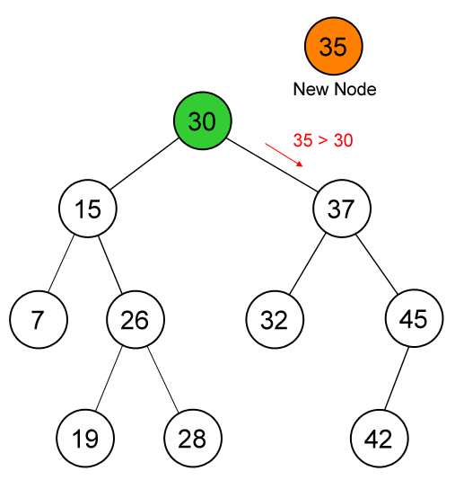
Operations: Insertion – Example
Inserting new
key (35)

Slide 11
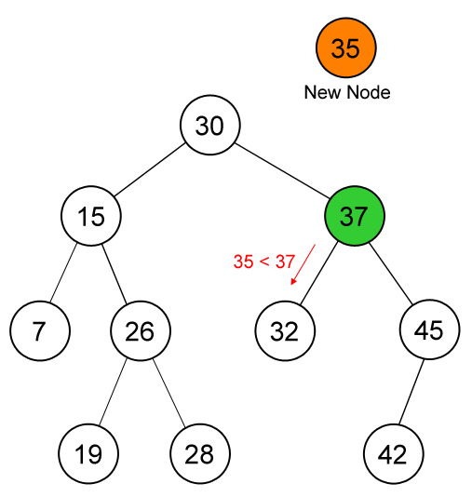
Operations: Insertion – Example

Slide 12
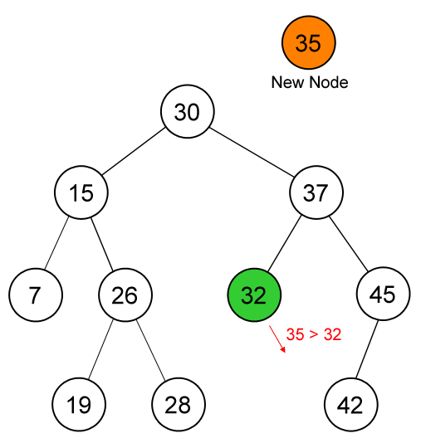
Operations: Insertion – Example

Slide 13
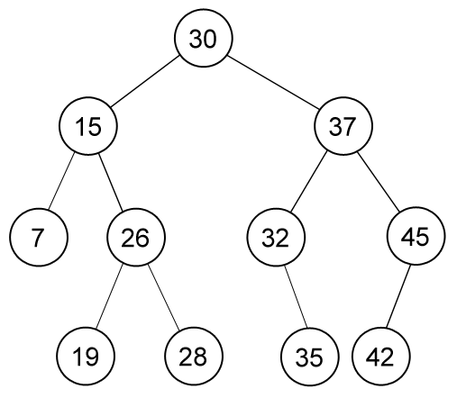
Operations: Insertion – Example

Slide 14
Operations: Deletion
There are 3 cases which should be considered:
If the key is in a leaf, just delete that node
If the key is in a node which has one child, delete that node and connect its child to its parent
If the key is in a node which has two children, find the right most child of its left sub tree (node P), replace its key with P’s key and remove P recursively. (or alternately you can choose the left most child of its right sub tree)

Slide 15
Operations: Deletion
Algorithm:
Step 1: IF TREE = NULL, then
Write “VAL not found in the tree”
ELSE IF VAL < TREE->DATA
Delete(TREE->LEFT, VAL)
ELSE IF VAL > TREE->DATA
Delete(TREE->RIGHT, VAL)
ELSE IF TREE->LEFT AND TREE->RIGHT
SET TEMP = findLargestNode(TREE->LEFT)
SET TREE->DATA = TEMP->DATA
Delete(TREE->LEFT, TEMP->DATA)

Slide 16
Operations: Deletion
Algorithm:
ELSE
SET TEMP = TREE
IF TREE->LEFT = NULL AND TREE ->RIGHT = NULL
SET TREE = NULL
ELSE IF TREE->LEFT != NULL
SET TREE = TREE->LEFT
ELSE
SET TREE = TREE->RIGHT
FREE TEMP
Step 2: End

Slide 17
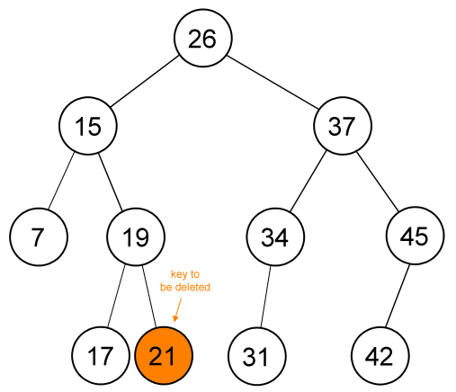
Operations: Deletion – Example
Deleting key (21)

Slide 18
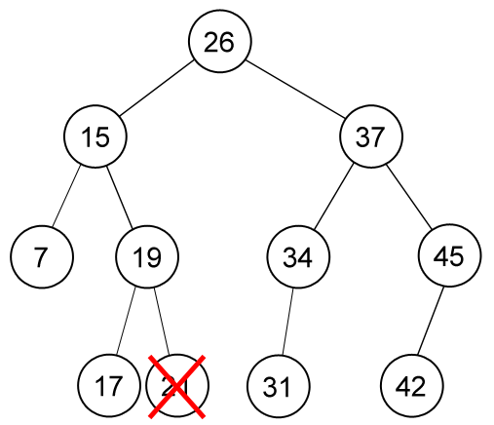
Operations: Deletion – Example
Deleting key (21),
(continue)

Slide 19
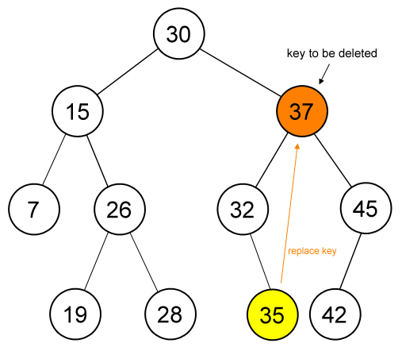
Operations: Deletion – Example
Deleting key (37)

Slide 20
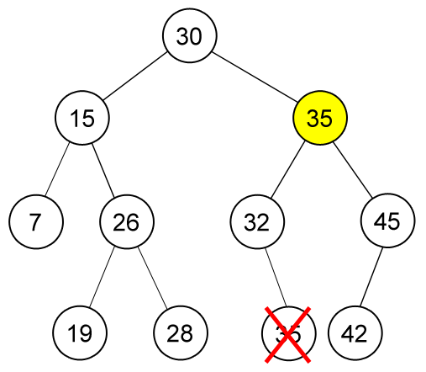
Operations: Deletion – Example
Deleting key (37),
(continue)

Slide 21
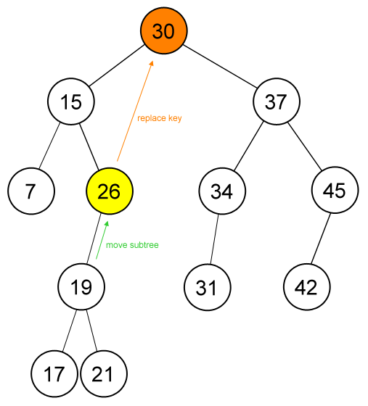
Operations: Deletion – Example
Deleting key (30)

Slide 22
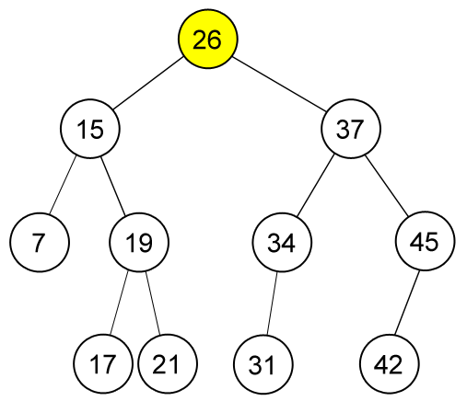
Operations: Deletion – Example
Deleting key (30),
(continue)

Slide 23
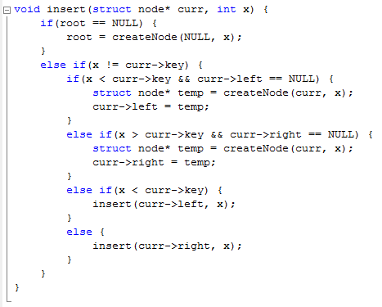
Program Example

Slide 24
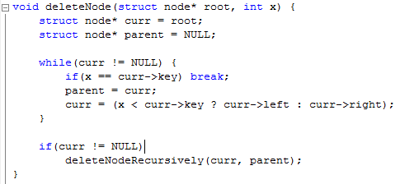
Program Example

Slide 25
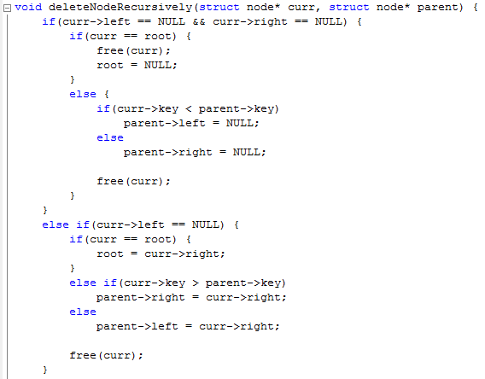
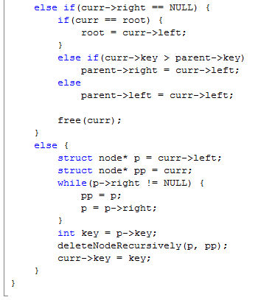
Program Example

Slide 26
References
S. Sridhar. 2015. Design and Analysis of Algorithms. Oxford University Press. New Delhi. ISBN: 9780198093695. Chapter 6
Reema Thareja. 2014. Data structures using C. Oxford University Press. New Delhi. ISBN:9780198099307. Chapter 10
Thomas H. Cormen, Charles E. Leiserson, Ronald L. Rivest, & Clifford Stein. (2009). Introduction to Algorithms. 03. The MIT Press. London. ISBN: 9780262033848. Chapter 12
Binary Search Tree, https://visualgo.net/bn/bst?slide=1

